Slide 1
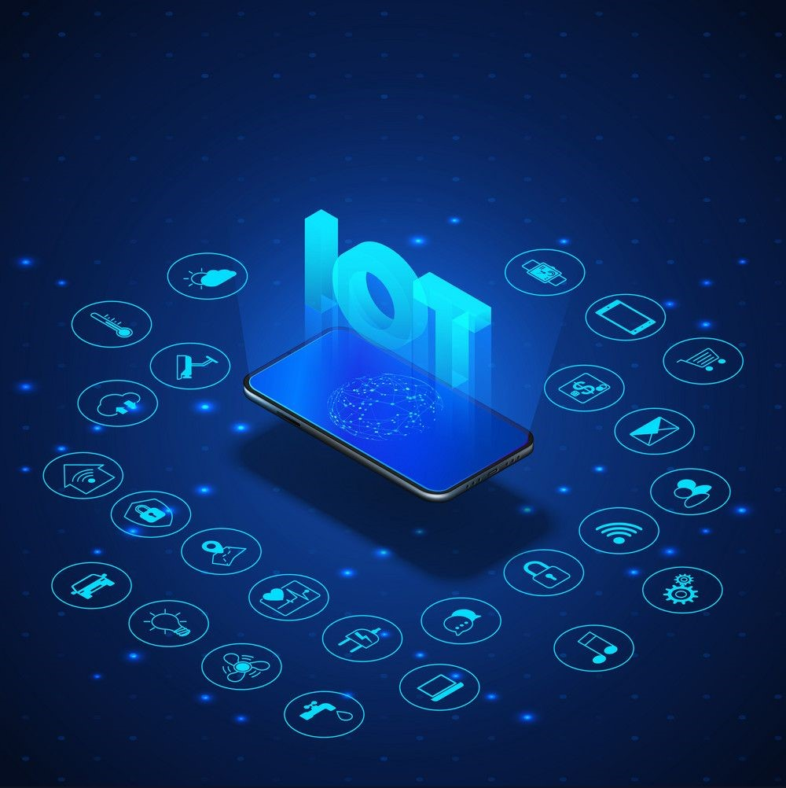
SMART
IRRIGATION
SYSTEM
(USING IOT)

Slide 2

PRESENTED BY:
AKSHAT DWIVEDI
(181500062)
PRAKHAR SRIVASTAVA
(181500471)
SRISTI SHUKLA
(181500727)
SIMRAN GUPTA
(181500713)
AVIRAL ABEL WILLY
(181500162)

Slide 3
INTRODUCTION
Agriculture is the major source of income for the largest population in India and is major contributor to Indian economy.
Most of the farmers use large portions of farming land and it becomes very difficult to reach and track each corner of large lands. Sometime there is a possibility of uneven water sprinkles. This result in the bad quality crops which further leads to financial losses.
The Smart irrigation System has wide scope to automate the complete irrigation system..
It will not only automatically irrigate the water based on the moisture level in the soil but also send the Data to ThingSpeak Server to keep track of the land condition..The System will consist a water pump which will be used to sprinkle water on the land depending upon the land environmental condition such as Moisture, Temperature and Humidity.

Slide 4
WHY WE NEED SMART IRRIGATION SYSTEM ?
Most of the farmers use large portions of farming land and it becomes very difficult to reach and track each corner of large lands.
Sometimes there is a possibility of uneven water sprinkles. The result is bad quality crop which further use to financial losses. In this scenario the Smart Irrigation System using latest IOT technology is helpful and leads to ease of farming.
In 31 March 2018, three farmers died due to electric shock at the time of watering to the plants and so many case of electric shock died farmers at the time of given water to the plants.

Slide 5
Components Required
ARDUNIO.
Soil Moisture Sensor Module.
Water Pump Module.
Relay Module.
Jumper Wire.

Slide 6
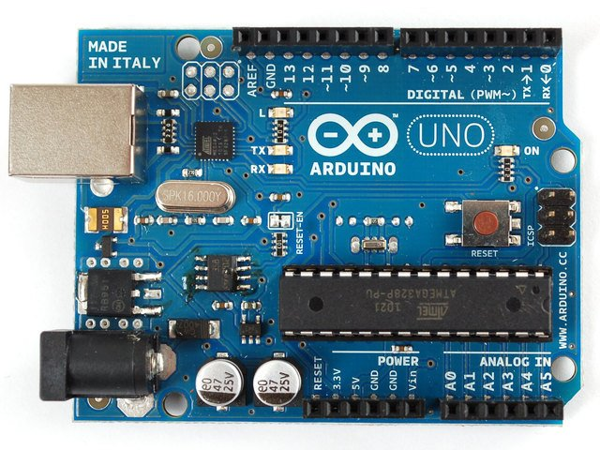
Arduino
Arduino is an open-source electronics platform based on easy-to-use hardware and software.
Arduino boards are able to read inputs - light on a sensor, a finger on a button, or a Twitter message - and turn it into an output - activating a motor, turning on an LED, publishing something online.
You can tell your board what to do by sending a set of instructions to the microcontroller on the board. To do so you use the Arduino programming language (based on Wiring), and the Arduino Software (IDE), based on Processing.

Slide 7
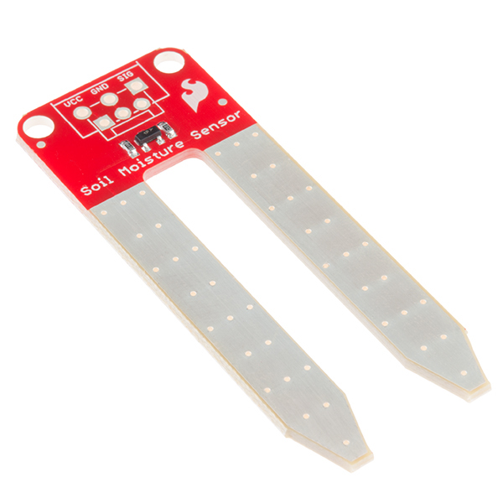
SOIL MOISTURE SENSOR MODULE
Soil moisture sensors measure the volumetric water content in soil.^{[1]} Since the direct gravimetric measurement of free soil moisture requires removing, drying, and weighing of a sample, soil moisture sensors measure the volumetric water content indirectly by using some other property of the soil, such as electrical resistance, dielectric constant, or interaction with neutrons, as a proxy for the moisture content. The relation between the measured property and soil moisture must be calibrated and may vary depending on environmental factors such as soil type, temperature, or electric conductivity

Slide 8
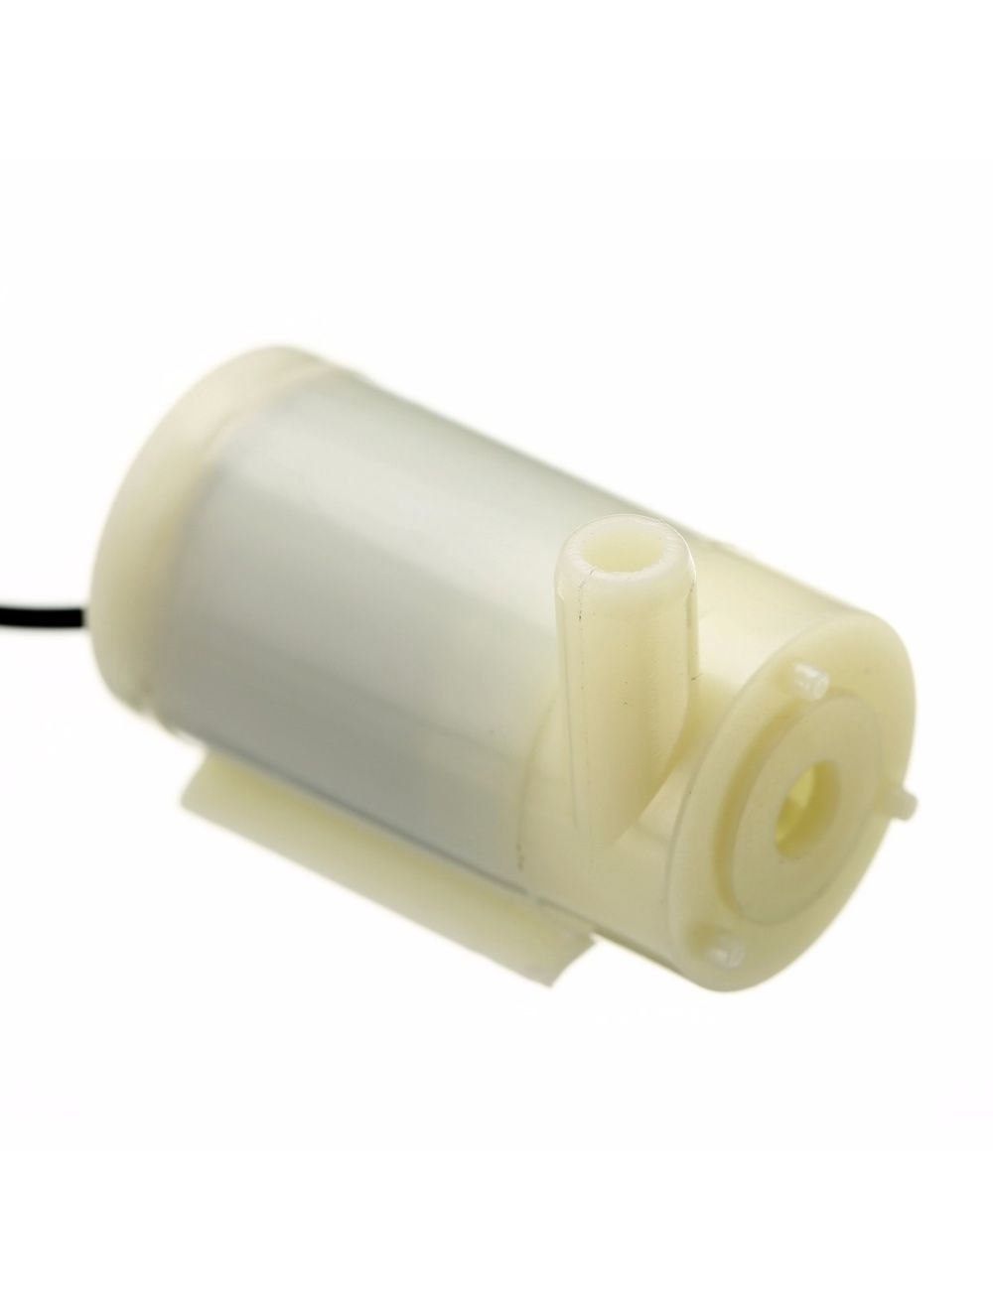
Water Pump Module
Specification:
Operating Voltage : 2.5 ~ 6V.
Operating Current : 130 ~ 220mA.
Flow Rate : 80 ~ 120L/H.
Maximum Lift : 40 ~ 110.
Continuous Working Life : 500 hours.
Driving Mode : DC, Magnetic Driving.
Outlet Outside Diameter : 7.5mm.
Outlet Inside Diameter : 5mm.

Slide 9
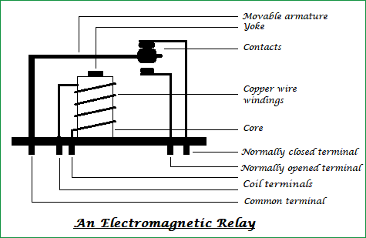
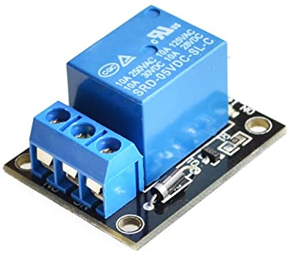
Relay Module
A standard and generally used relay is made up of electromagnets which in general used as a switch . Dictionary says that relay means the act of passing something from one thing to another, the same meaning can be applied to this device because the signal received from one side of the device controls the switching operation on other side.

Slide 10
Jumper Wire
A jump wire (also known as jumper, jumper wire, jumper cable, DuPont wire or cable) is an electrical wire, or group of them in a cable, with a connector or pin at each end (or sometimes without them – simply "tinned"), which is normally used to interconnect the components of a breadboard or other prototype or test circuit, internally or with other equipment or components, without soldering.
Individual jump wires are fitted by inserting their "end connectors" into the slots provided in a breadboard, the header connector of a circuit board, or a piece of test equipment

Slide 11
TYPES OF JUMPER WIRES
Jumper wires typically come in three versions: male-to-male, male-to-female and female-to-female. The difference between each is in the end point of the wire. Male ends have a pin protruding and can plug into things, while female ends do not and are used to plug things into. Male-to-male jumper wires are the most common and what you likely will use most often. When connecting two ports on a breadboard, a male-to-male wire is what you’ll need.

Slide 12
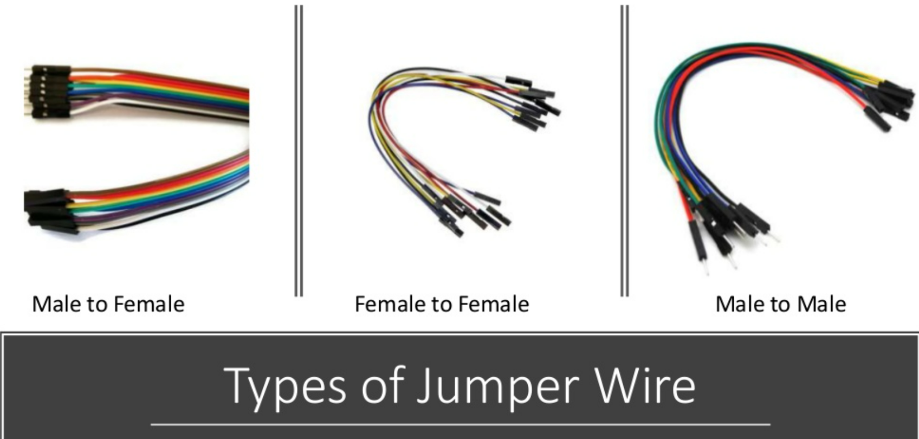

Slide 13
ADVANTAGES
To save water.
Smart irrigation also deals with efficiencies in delivery of water. There are generally four types of delivery: surface, sprinklers, trickle and surface method.
It distributes water through irrigation ditches, letting gravity do the work.
Sprinklers distribute water through the air like rain and can be fixed or mobile.
Trickle irrigation spreads water very locally to the ground surface.
Controlling these two set points reduce the amount of water used by linking it to the moisture level needed in the soil for a particular crop.
A particular land area is too dry and starting an irrigation routine or to stop irrigation when a particular saturation point is met because a soil moisture level has been reached.
Use local soil moisture data drawn from sensors in the ground to support informed decisions about watering schedule.

Slide 14
DISADVANATAGES
Agriculture being a natural phenomenon relies mostly on nature, and man predict or control nature let it be rain drought sunlight availability, pests control etc. So ever implementation IOT system agriculture.
The agriculture need availability on internet continuously. Rural part of developing countries did not fulfill this requirements. Moreover internet is slower.
Fault sensor or data processing engines can cause faulty I decisions which may lead to over use of water, fertilizers and other wastage of resources.
The smart faming based equipment require farmer to understand and the learn the use of technology. This is the major challenge in adopting smart agriculture farming at large scale across the continues.
It also has some issue which have to tracked properly in order to attain the full benefit of it.
The current IOT system are not scalable or reliable and the initial costs are high which the farmer cannot afford.

Slide 15


